Slide 1
Java encapsulation and access modifiers
Lecture # 4

Slide 2
Encapsulation
What is it?
Encapsulation simply means binding object state(fields) and behavior (methods) together. If you are creating class, you are doing encapsulation.
In other words, Encapsulation is binding the data with the code that manipulates it.
Bundling or wraping together data members and functions of objects inside respective classes.

Slide 3
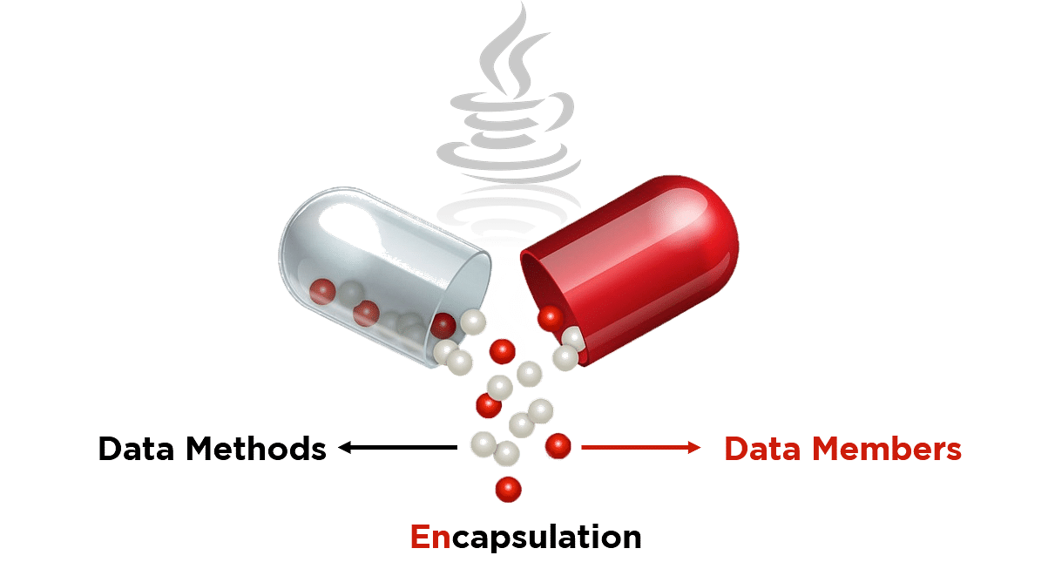
encapsulation

Slide 4
Encapsulation example
class Rectangle {
public int length;
public int breadth;
public int getArea() {
return length * breadth;
}
};

Slide 5
Encapsulation: data hiding
Encapsulation is also known as “Data Hiding“.
Encapsulation ensures that "sensitive" data is hidden from users.
To achieve this:
declare class variables/instance variables (attributes) as private so that they cannot be accessed directly from outside the class.
provide public get and set methods to access and update the value of a private variable
User would not be knowing what is going on behind the scene. They would only be knowing that to update a field call set method and to read a field call get method but what these set and get methods are doing is purely hidden from them.
It keeps the data and the code safe from external interference.

Slide 6
Encapsulation: advantages/benefits
Better Organization, Maintainability and Reuse of the large codebase.
Enables you to set variables as red or write-only. Better control of class attributes and methods, hence increase security.
With encapsulation, it's easy to change and adapt to new requirements. Changes made to one part of the code can be successfully implemented without affecting any other part of the code.
The encapsulated class is easy to test, so it is also better for unit testing.

Slide 7
Defining Encapsulation
Encapsulation is one of the four important OOP concepts.
It refers to two related but distinct notions:
A language construct that facilitates the bundling of variables (data) with the methods (code) operating on those data into a single unit ----class.
A language mechanism for restricting direct access to some of the object's components.

Slide 8
Encapsulation
Real World Example:
Looking at the example of a power steering mechanism of a car. Power steering of a car is a complex system, which internally have lots of components tightly coupled together, they work synchronously to turn the car in the desired direction. It even controls the power delivered by the engine to the steering wheel. But to the external world there is only one interface is available and rest of the complexity is hidden. Moreover, the steering unit in itself is complete and independent. It does not affect the functioning of any other mechanism.
Similarly, same concept of encapsulation can be applied to code. Encapsulated code should have following characteristics:
Everyone knows how to access it.
Can be easily used regardless of implementation details.
There shouldn’t any side effects of the code, to the rest of the application.
The idea of encapsulation is to keep classes separated and prevent them from having tightly coupled with each other.

Slide 9
Packages in java
A package is a pack(group) of classes, interfaces and other packages.
We use packages to organize our classes and interfaces.
We have two types of packages in Java: built-in packages and the packages we can create (also known as user defined package).
In java we have several built-in packages
import java.util.Scanner
Here: → java is a top level package → util is a sub package → and Scanner is a class which is present in the sub package util.

Slide 10
Package declaration example
package letmecalculate;
public class Calculator {
public int add(int a, int b){
return a+b;
}
public static void main(String args[]){
Calculator obj = new Calculator(); System.out.println(obj.add(10, 20));
} }

Slide 11
example contd…importing package
//Declaring a package
package anotherpackage;
//importing a package
import letmecalculate.Calculator;
public class Example{
public static void main(String args[]){
Calculator obj = new Calculator(); System.out.println(obj.add(100, 200));
} }

Slide 12
What if do not import a package???
We can use fully qualified name to avoid the import statement.
Modify the previous example program in the class

Slide 13
Important Points
Class name conflict may occur, even after creating packages.
For example: Lets say we have two packages abcpackage and xyzpackage and both the packages have a class with the same name, let it be JavaExample.java. Now suppose a class imports both these packages like this:
import abcpackage.*;
import xyzpackage.*;
This will throw compilation error.
Solution???
use the fully qualified names
abcpackage.JavaExample obj = new abcpackage.JavaExample();
xyzpackage.JavaExample obj2 = new xyzpackage.JavaExample();

Slide 14
Important Points
If we create a class inside a package while importing another package then the package declaration should be the first statement, followed by package import. For example:
package abcpackage;
import xyzpackage.*;

Slide 15
Important Points
The wild card import like package.* should be used carefully when working with subpackages.
For example:
Lets say: we have a package abc and inside that package we have another package foo, now foo is a subpackage.
classes inside abc are: Example1, Example 2, Example 3 classes inside foo are: Demo1, Demo2
So if I import the package abc using wildcard like: import abc.*; It will only import classes Example1, Example2 and Example3 but it will not import the classes of sub package.
To import the classes of subpackage you need to import like this:
import abc.foo.*;
This will import Demo1 and Demo2 but it will not import the Example1, Example2 and Example3.
So to import all the classes present in package and subpackage, we need to use two import statements like this:
import abc.*;
import abc.foo.*;

Slide 16
Advantages of using a package in Java
Better Organization: Again, in large java projects where we have several hundreds of classes, it is always required to group the similar types of classes in a meaningful package name so that you can organize your project better and when you need something you can quickly locate it and use it, which improves the efficiency.
Name Conflicts: We can define two classes with the same name in different packages so to avoid name collision, we can use packages

Slide 17
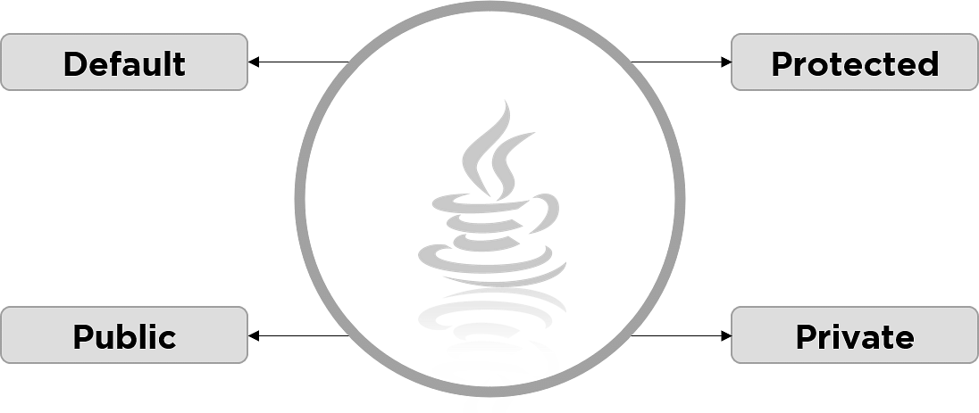
Data hiding in java
An access modifier restricts the access of a class, constructor, data member and method in another class.
In java we have four access modifiers:

Slide 18
Public access modifier
This modifier doesn’t put any restriction on the access.
The members, methods and classes that are declared public can be accessed from anywhere.

Slide 19
Default access modifier
No modifier - When we do not mention any access modifier, it is called default access modifier.
The scope of this modifier is limited to the package only.
This means that if we have a class, method or a data member with the default access modifier, it can be accessed or viewed from within the same class or from all other classes in the same package.

Slide 20
Default access modifier example
package abcpackage;
public class Addition {
/* we didn't mention any access modifier with the method*/
int addTwoNumbers(int a, int b){
return a+b; }
}
package xyzpackage;
import abcpackage.*;
public class Test { public static void main(String args[]){ Addition obj = new Addition(); // It will throw error obj.addTwoNumbers(10, 21);
} }
Run example class to see the compile time error
Then verify with public modifier too

Slide 21
Private access modifier
The scope of private modifier is limited to the class only.
Private data members and methods are only accessible within the class
Class and Interface cannot be declared as private
If a class has private constructor then you cannot create the object of that class from outside of the class.
Perform Example in Class…

Slide 22
Protected Access Modifier
Classes cannot be declared protected!
Protected data member and method are only accessible by the classes of the same package and the subclasses present in any package.
You can also say that the protected access modifier is similar to default access modifier with one exception that it has visibility in sub classes.
This access modifier is generally used in a parent child relationship.
Do the example in the class…

Slide 23
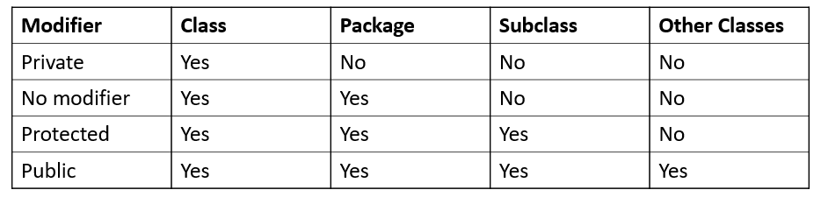
The scope of access modifiers

Slide 26
The primary purpose of object-oriented programming is to increase the readability, flexibility and maintainability of programs.
Object oriented programming brings data and its behaviour together in a single entity called objects.
An object can be represented as an entity that has state and behaviour. For example: A car is an object that has states such as color, model, price and behaviour such as speed, start, gear change, stop etc.
Let’s understand the difference between state and behaviour. The state of an object is a data item that can be represented in value such as price of car, color, consider them as variables in programming. The behaviour is like a method of the class, it is a group of actions that together can perform a task. For example, gear change is a behaviour as it involves multiple subtasks such as speed control, clutch, gear handle movement.

Slide 27
Abstraction
Abstraction is a process where you show only “relevant” data and “hide” unnecessary details of an object from the user. For example, when you login to your bank account online, you enter your user_id and password and press login, what happens when you press login, how the input data sent to server, how it gets verified is all abstracted away from the you.

Slide 28
Abstract Class
Here we have an abstract class Animal that has an abstract method animalSound(), since the animal sound differs from one animal to another, there is no point in giving the implementation to this method as every child class must override this method to give its own implementation details. That’s why we made it abstract.
Now each animal must have a sound, by making this method abstract we made it compulsory to the child class to give implementation details to this method. This way we ensures that every animal has a sound.

